Slide 1
Detection of AI generated images
Ante Čavar
Fran Lubina
Paula Moničić
Mihael Pristav

Slide 2
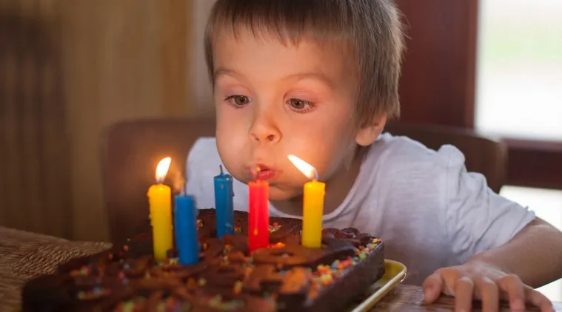
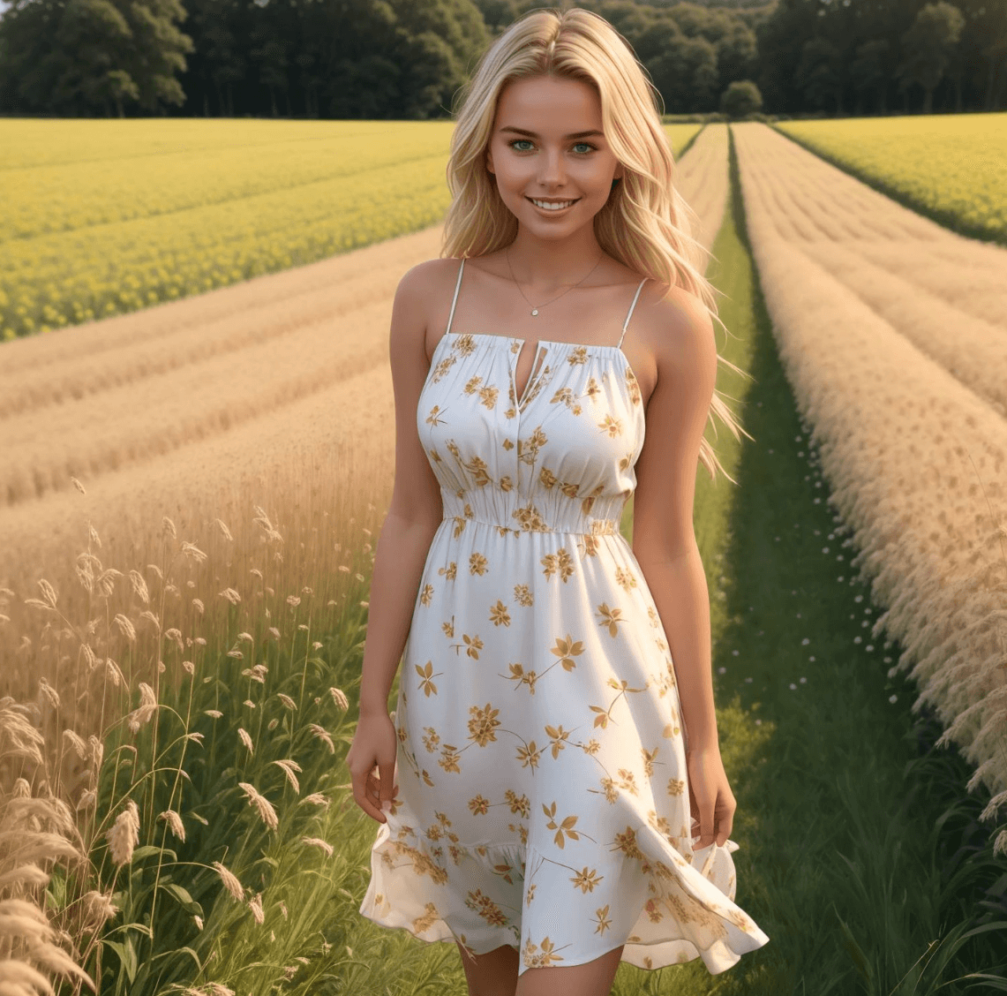

Ai generated images
AI models for image generation
Rapid advancement
Human noticeable differences
Computer noticeable differences

Slide 3
Detection of AI generated images
Moderating content on online platforms
Digital forensics
Fraud prevention

Slide 4
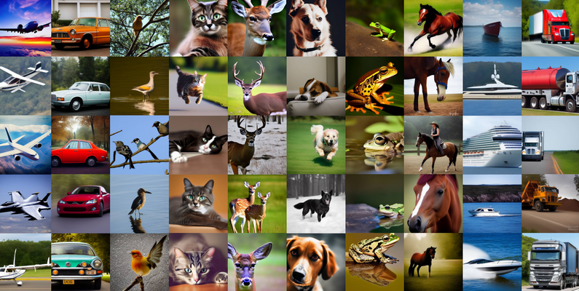
Our Goal
Binary image classification (AI - real)
A harder task against newer generative models
  No obvious texture marks
  No frequency spectrum anomalies

Slide 5
Our approach
Convolution neural network (CNN)
  Invaluable in working with images
  Work well with local features
  Work well with textural anomalies
CIFAKE dataset
CNNs with softmax and dense layer
  Poor generalization
  Possible solution? Replacing the final layers?

Slide 6
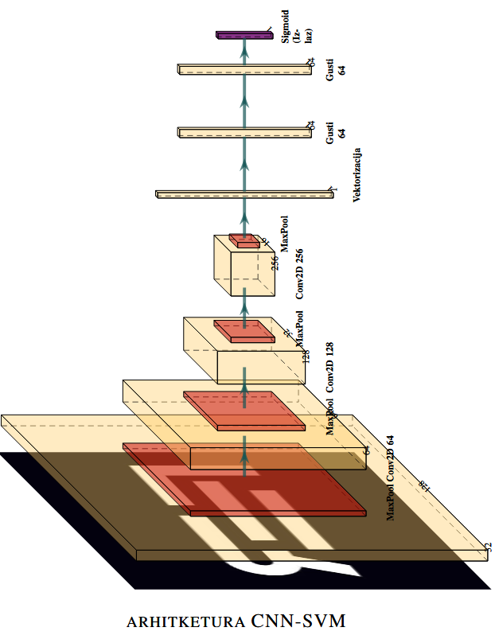
Convolutional Neural Network

Slide 7
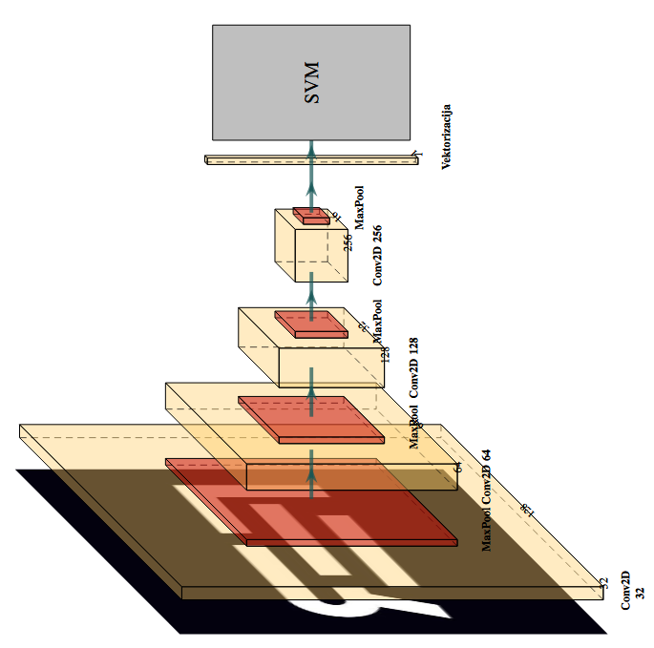
CNN → SVM

Slide 8
Training
100 000 images (CIFAKE)
During development we used the following split:
    CNN: 8:72:20
    The SVM itself: 0:80:20
For the validation, train and test sets respectively

Slide 9
Training
Hyperparameter grid search
  SVM: C and γ
To facilitate learning:
  Images are scaled to a fixed size
  Normalized

Slide 10
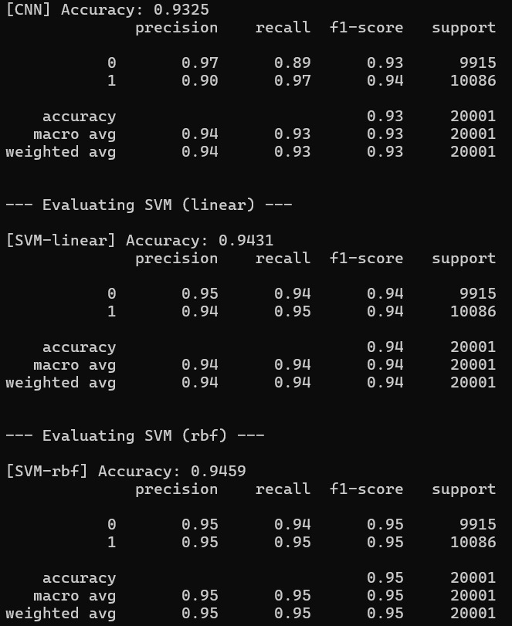
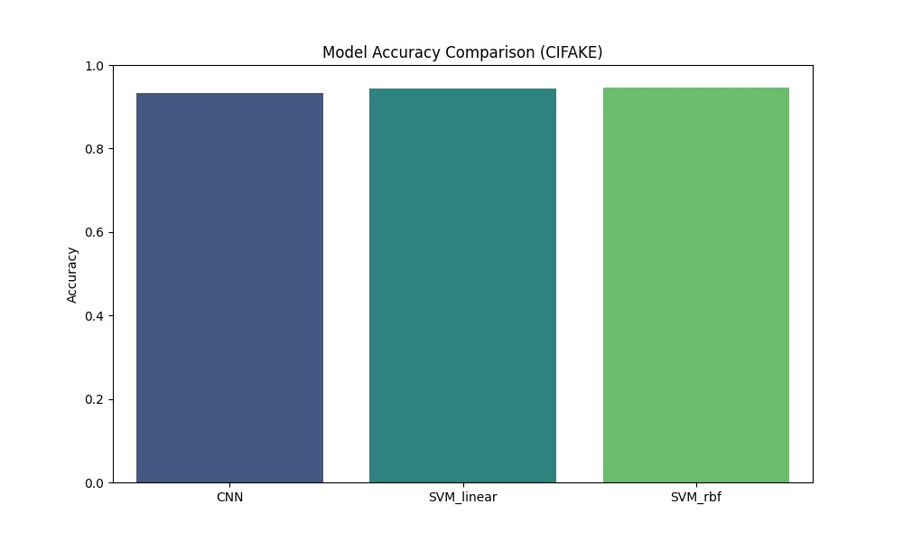
Results
High accuracy
Models almost identical
  RBF wins out barely

Slide 11
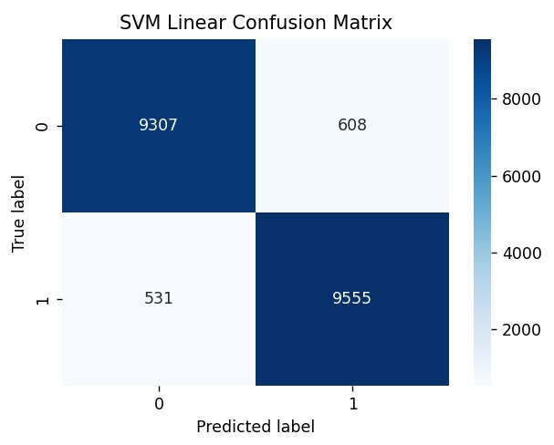
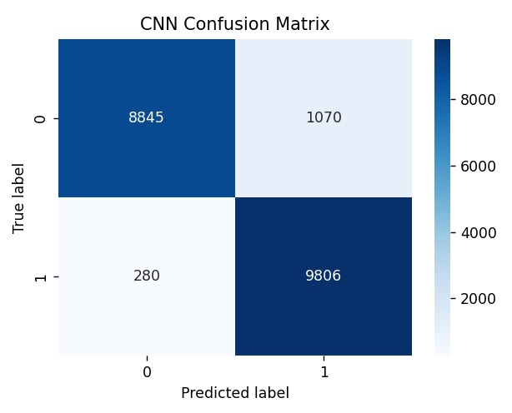
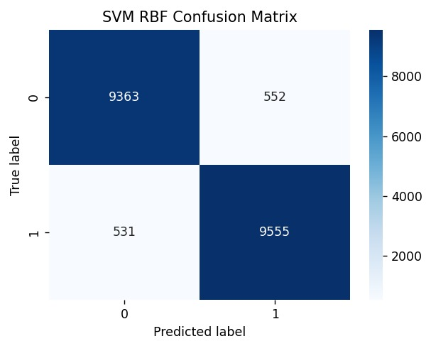
CONFUSION MATRICES

Slide 12
Results discussion
All models have a very similar accuracy
  structurally very similar
    Same feature extractor
    Different decision layer
CNN + SVM performs better because it is the best of both worlds
  CNN feature extration
  SVM decision

Slide 13
Results discussion
Better accuracy than ordinary CNNs
Worse accuracy than newer transformer based architectures

Slide 14
Results discussion: transformer based solutions
Better cross-retention
  Better global pattern recongnition
ViT (Vision Transformer)
Convolutional Vision Transformer (CvT)

Slide 15


THE END
Any questions?

